Slide 1


“Mid-term Project”
“Railway Ticket Booking System “
Submitted by:
Submission type : Individual
Name: Lekhana Neethipudi
Batch : 12th
LMS Id : lekhana.neethipudi20@gmail.com
Program : Fintech
Date:31/05/2023

Slide 2

Table of contents
Introduction
Project Overview
Architecture Design
User Interface Design
Back-end Development
Front-end Development
Conclusion
Future Work
References
Appendices

Slide 3
Introduction
The railway ticket booking system facilitates the passengers to enquiry about the trains available on the basis of source and destination, booking and cancellation of tickets. The aim of railway ticket booking system project is to design and develop a database maintaining records of different trains and passengers. Project contains introduction to the railway ticket booking system. It is the computerized system of reserving the seats of train seats in advance. Online reservation has made the process for the reservation of seats very much easier than ever before.

Slide 4
Project Overview
Admin Module:
Admin login
Add Train
View train list
Update Train settings
Delete Train
Search Train
View passengers booking list
Log out

Slide 5
Project Overview
User Module:
User Registration
User login
Search train
Booking a ticket
Update previous bookings
Cancel ticket
Drop a Feedback
Log out

Slide 6
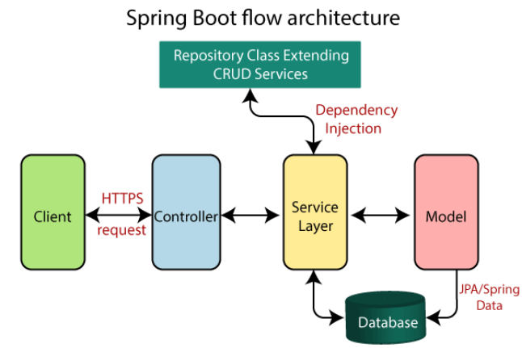
Architecture Design

Slide 7
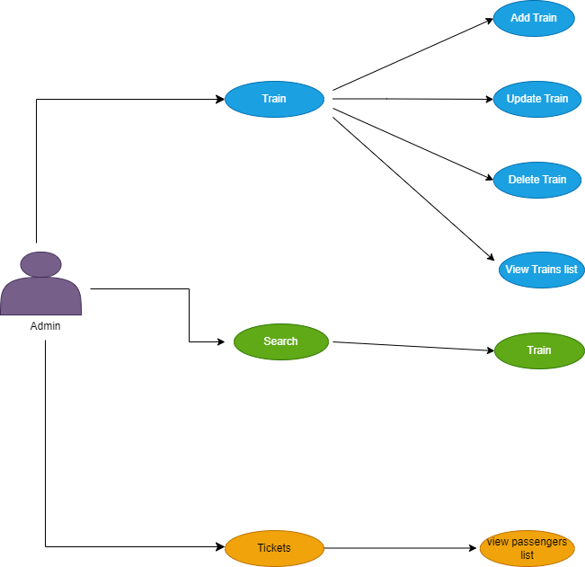
User Interface Design

Slide 8
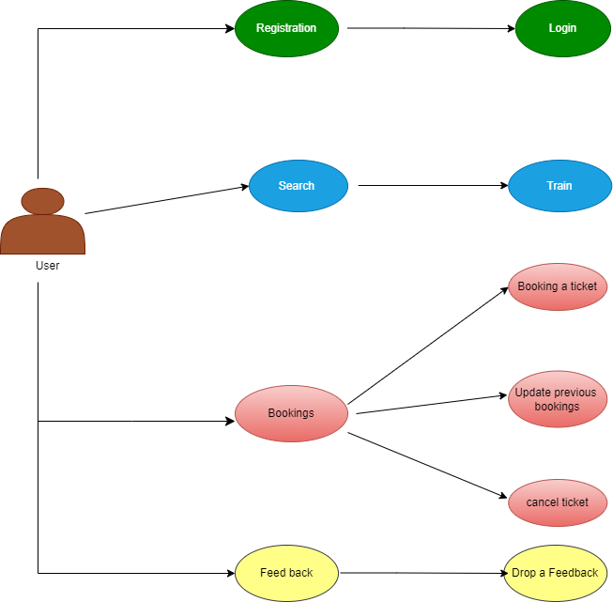
User Interface Design

Slide 9





Back-end Development
MySql5
Java8
Tomcat 10
Spring boot4
Spring Security6
Lombok
JPA

Slide 10




Front-end Development
HTML5
CSS3
Thymeleaf
BootStrap5

Slide 11
Conclusion
In conclusion, the Train Ticket Booking System project aimed to develop a comprehensive and user-friendly platform for booking train tickets. The system provides a seamless and efficient ticket booking process, eliminating the need for long queues and manual paperwork. Users can easily search for train. The system offers an intuitive and user-friendly interface, making it easy for users to navigate through the booking process. Users can easily manage their booked tickets, including cancellation, rescheduling. The system incorporates robust security measures to protect user data.

Slide 12
Future Work
Internal connectivity: when user tries to book a ticket from a source to destination if there are no direct trains available . System should be feasible enough to calculate the connectivity timing between the two trains and book ticket for both the trains as a single ticket by the system
Improved Security and Authentication: Railway reservation systems will continue to prioritize security measures to protect user information and transactions. This could include implementing advanced encryption techniques, two-factor authentication, and robust fraud detection systems.
Advanced Seat Allocation Algorithms: Railway reservation systems may employ advanced algorithms to optimize seat allocation based on user preferences, such as proximity to facilities, traveling with companions, or specific coach preferences. These algorithms can ensure efficient seat utilization and improve customer satisfaction.

Slide 13
References
https://www.codeburps.com/post/spring-boot-form-login
Security with Spring | Baeldung
https://www.javaguides.net/2022/09/spring-boot-rest-api-crud-example-with-mysql-database.html
https://www.yawintutor.com/multiple-login-pages-using-spring-boot-security/

Slide 14
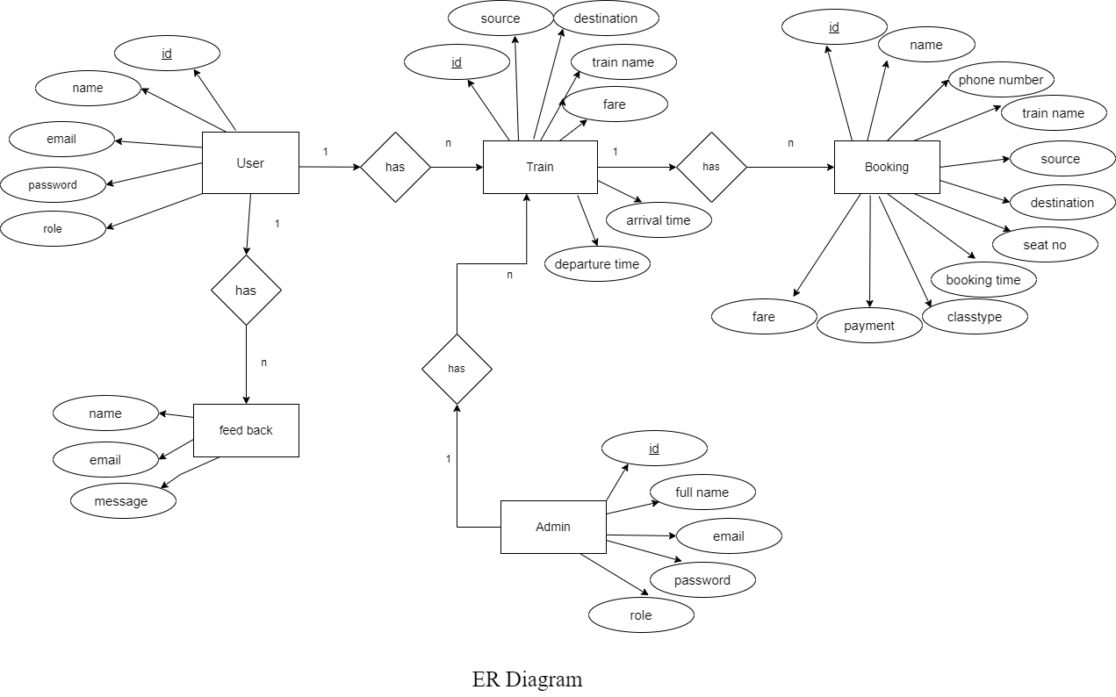
Appendices

Slide 15
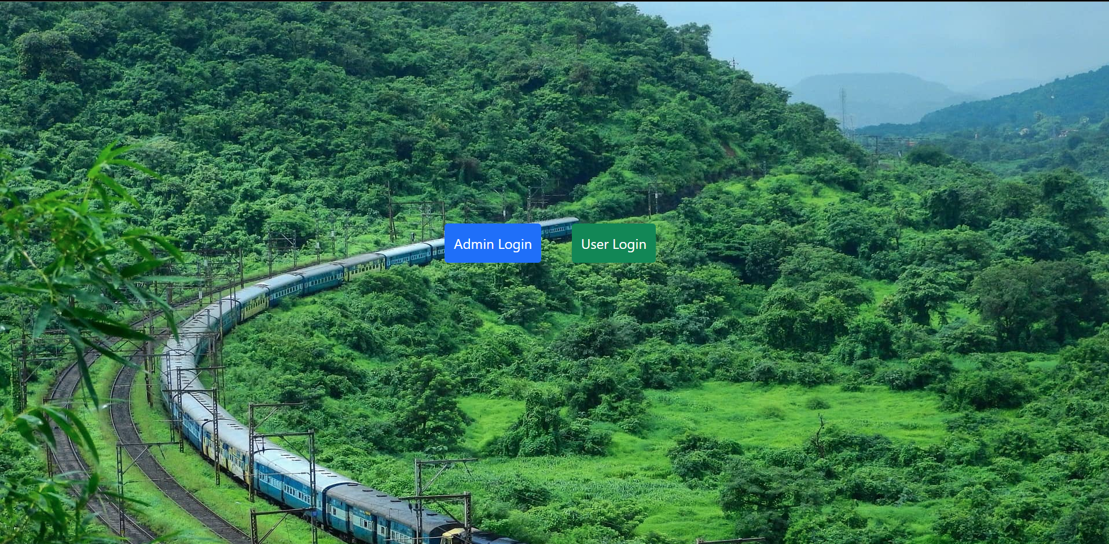
Appendices

Slide 16
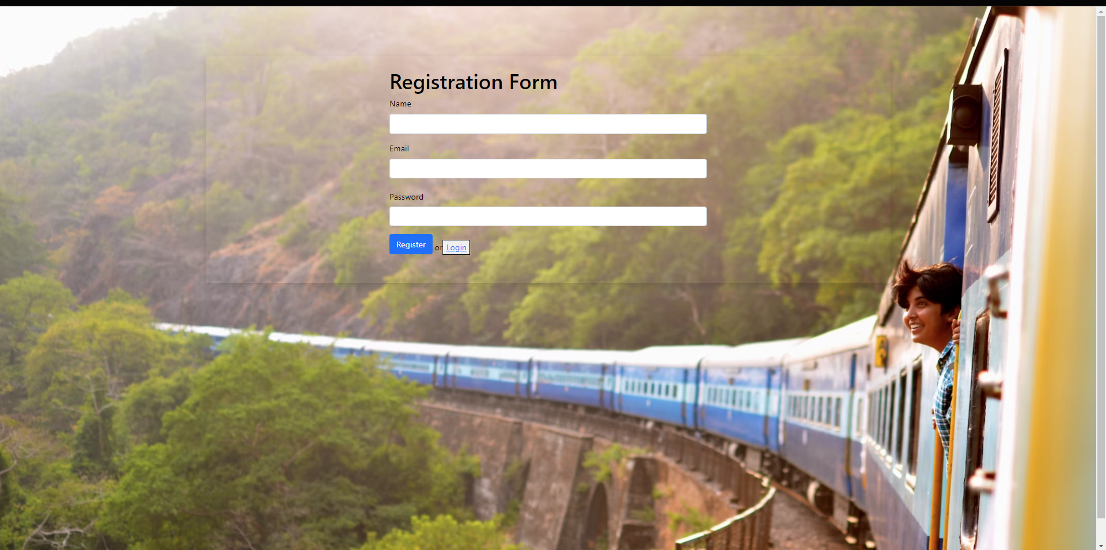
Appendices

Slide 17
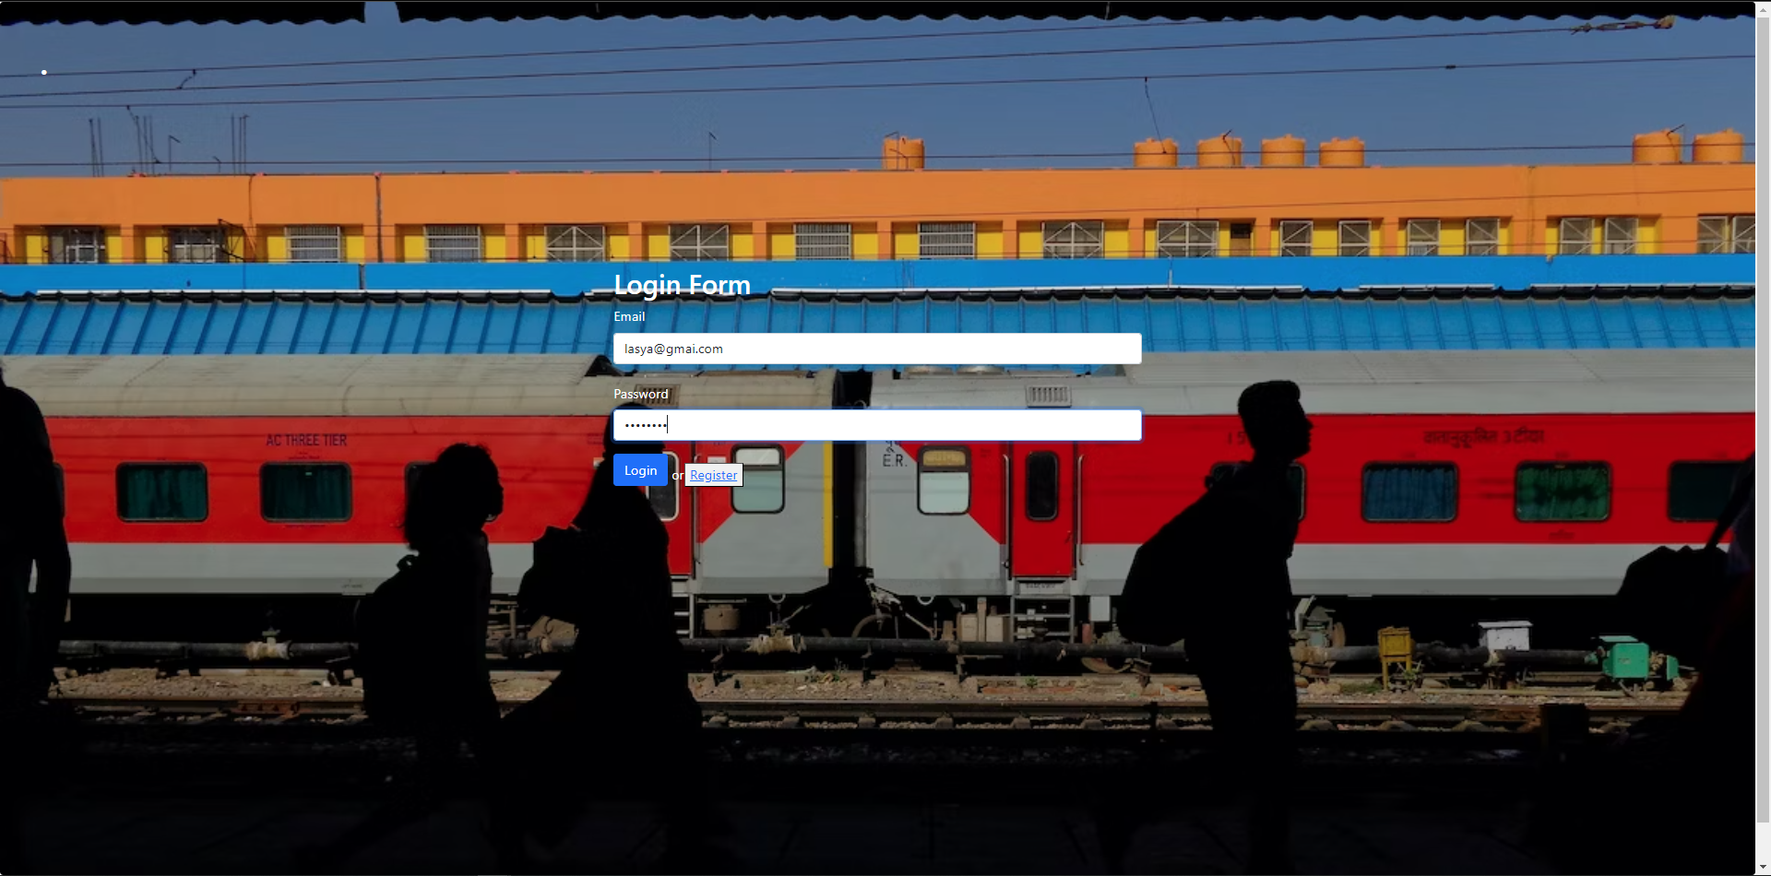
Appendices

Slide 18
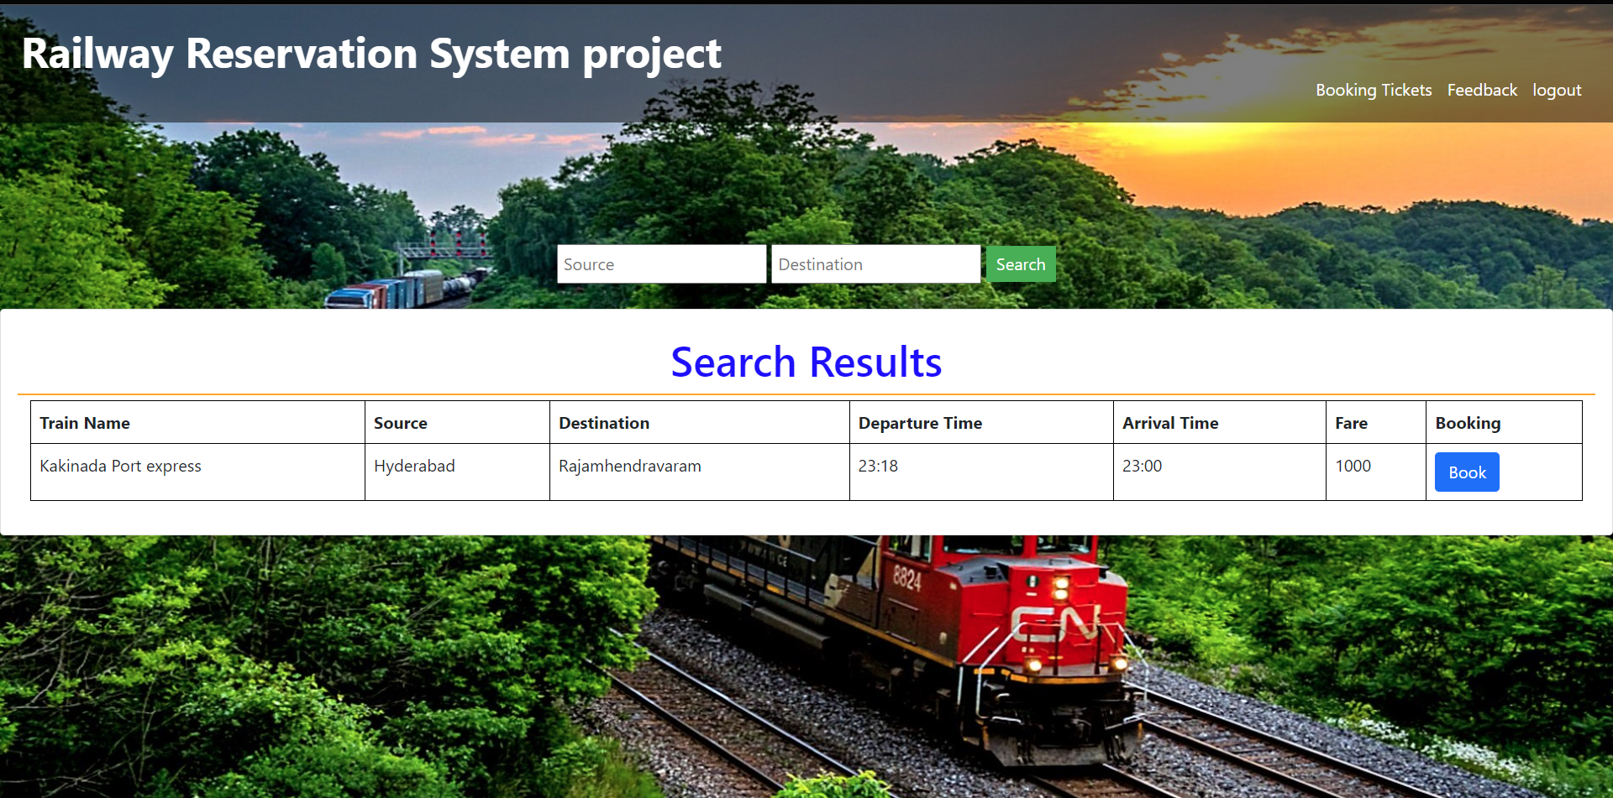
Appendices

Slide 19
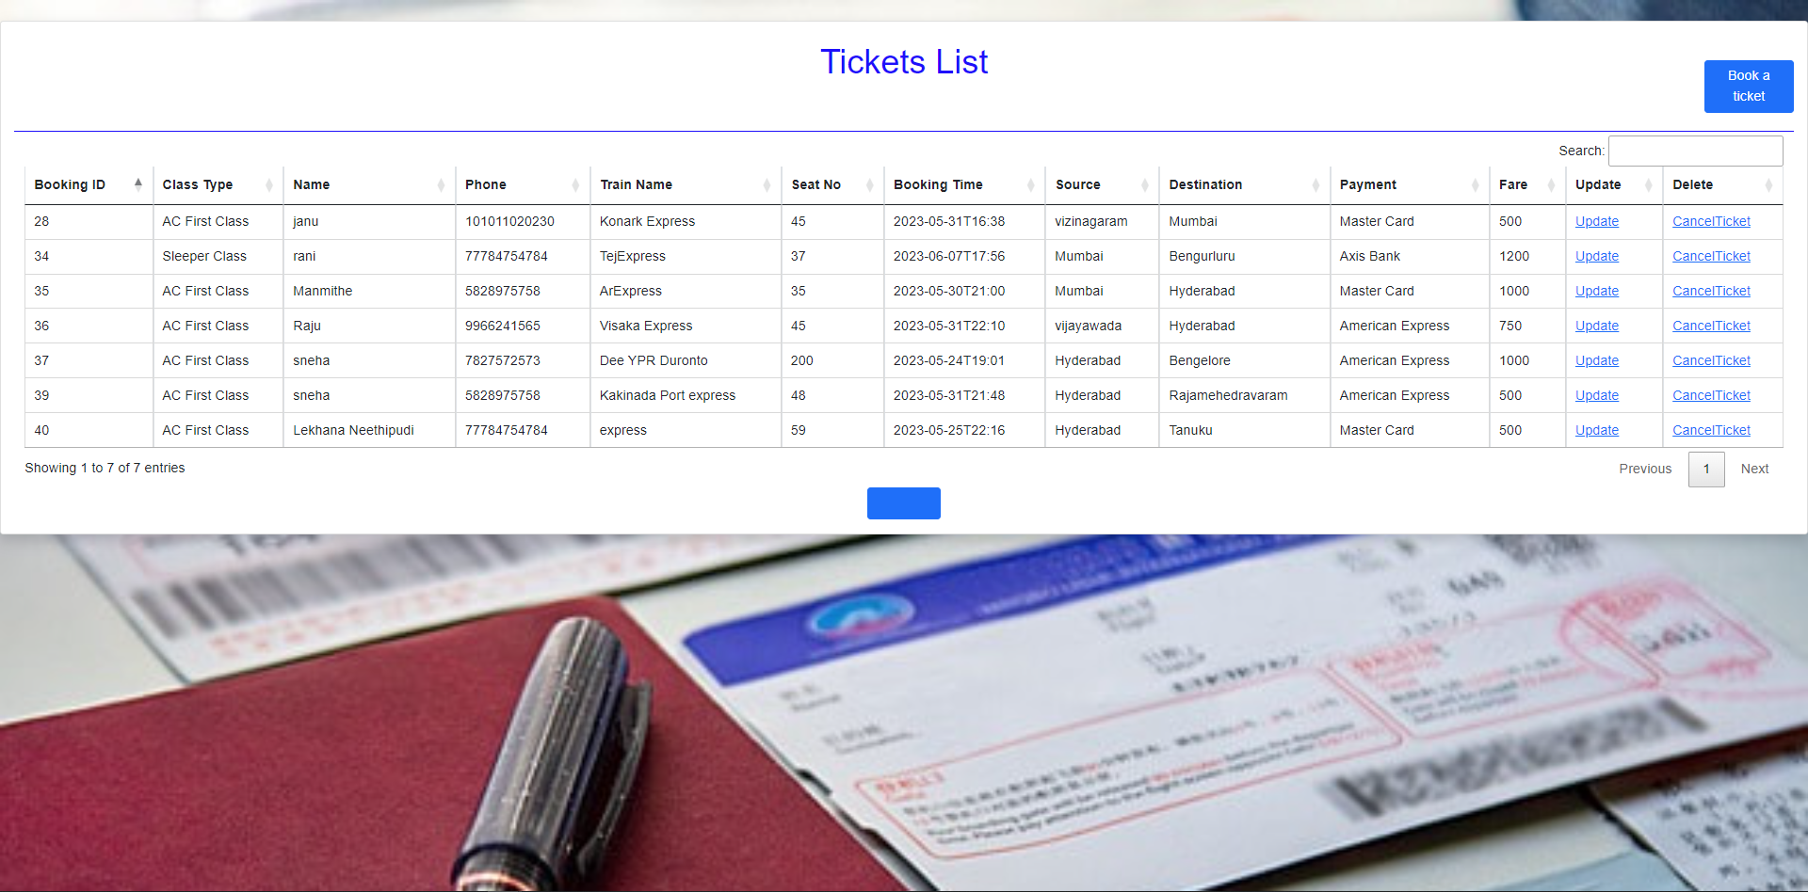
Appendices

Slide 20
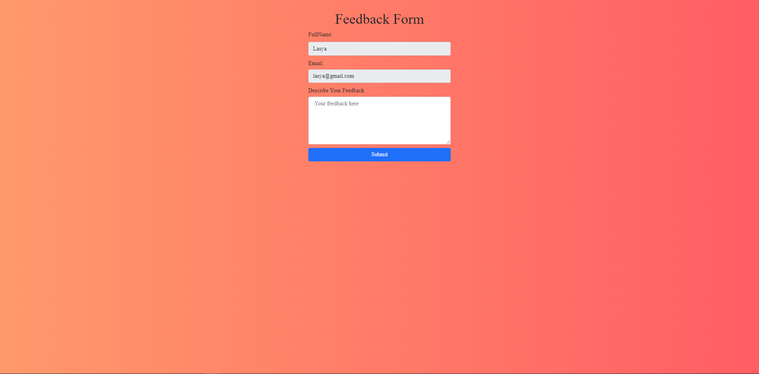
Appendices

Slide 21
Appendices
Thank You

